Slide 1


DiagonAlization, inverse and eigen values and vEctors of a matrix
PRESENTATION BY: MOLLY ,SONALI AND SHUBHAM SINGLA

Slide 2

Diagonalization
of matrix
Inverse of a matrix
Eigen values and vectors of a matrix
CONTENTS

Slide 3

Diagonalization
of matrix
An n×n matrix A is said to diagonalizable if it is similar to a diagonal matrix ,that there exists an invertible matrix P such that P^{^-1} A P is a diagonal matrix where D is a diagonal n×n matrix with the eigenvalues of A as its entries, and P is a nonsingular n×n matrix consisting of the eigenvectors corresponding to the eigenvalues in D.

Slide 4
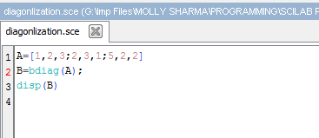
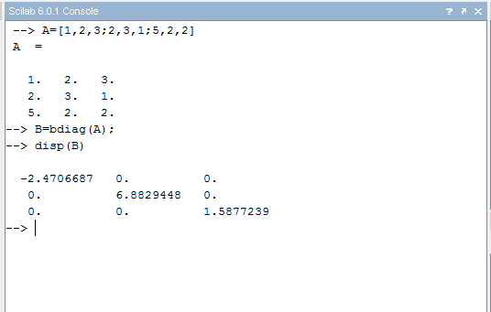
SCILAB PROGRAM

Slide 5
Inverse of matrix
In linear algebra, an n-by-n square matrix A is called invertible (also nonsingular or nondegenerate) if there exists an n-by-n square matrix B such that
AB=BA=I
where I_{n} denotes the n-by-n identity matrix and the multiplication used is ordinary matrix multiplication. If this is the case, then the matrix B is uniquely determined by A and is called the inverse of A, denoted by A⁻¹.
A square matrix that is not invertible is called singular.

Slide 6
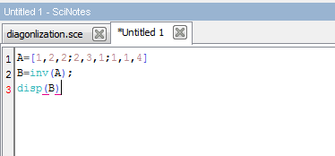
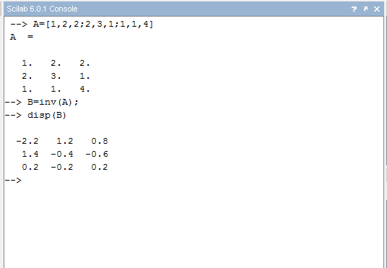
SCILAB PROGRAM

Slide 7
Eigen values and vectors of a matrix
An eigenvector is a vector whose direction remains unchanged when a linear transformation is applied to it.
A·v=λ·v
In this equation A is an n-by-n matrix, v is a non-zero n-by-1 vector and λ is a scalar (which may be either real or complex). Any value of λ for which this equation has a solution is known as an eigenvalue of the matrix A. It is sometimes also called the characteristic value. The vector, v, which corresponds to this value is called an eigenvector. The eigenvalue problem can be rewritten as
A·v-λ·v=0 A·v-λ·I·v=0 (A-λ·I)·v=0
If v is non-zero, this equation will only have a solution if
|A-λ·I|=0
This equation is called the characteristic equation of A, and is an n^{th} order polynomial in λ with n roots. These roots are called the eigenvalues of A.

Slide 8
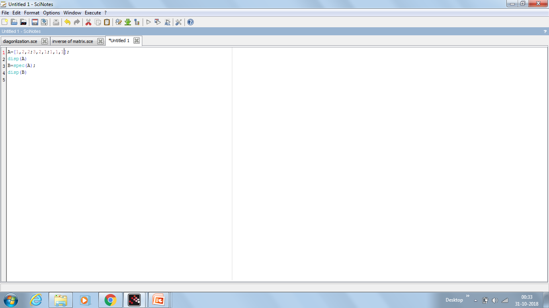
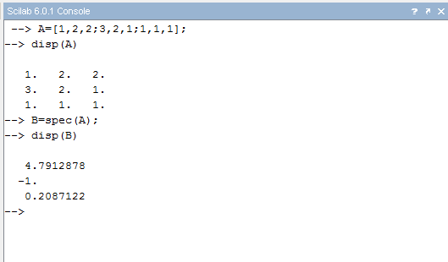
SCILAB PROGRAM

Slide 9
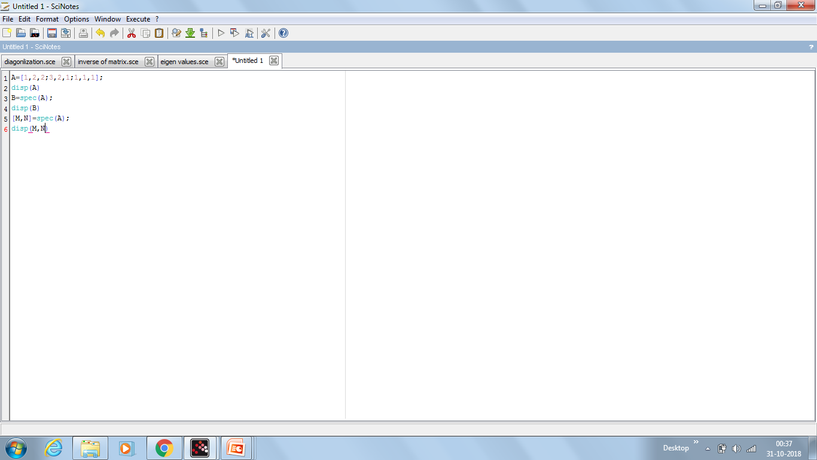
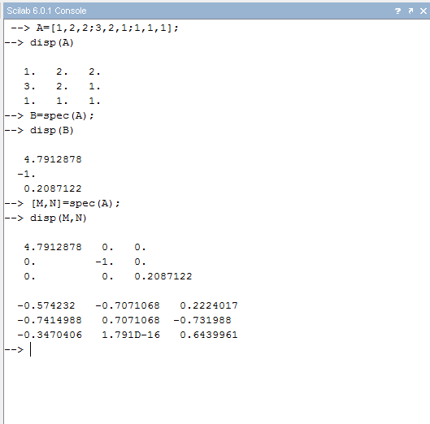

Slide 10
THANK YOU

